Slide 1
ATTENDANCE SYSTEM USING FACIAL RECOGNITION
INTERNSHIP PROJECT
ARTIFICIALINTELLIGENCE
NAVTTC BATCH III

Slide 2
SUBMITTED TO:
NEURON SOLUTIONS
SUBMITTED BY:
SARA AZMAT
SANA NAZ
DUA FATIMA
ANUM AZIZ

Slide 3
OVERVIEW
Any idea what is Smart Attendance System?
Smart Attendance System or Attendance System using Facial Recognition is a method that meticulouly recognize students using face biostatistics /coordinates based on high resolution/definition monitoring and advanced computer technologies.

Slide 4
SIGNIFICANCE
Minimize inevitable errors as in manual entries
Accurate time tracking
Time saving
Legal compliance
Transparency
Reduced workload
Reliability
Increased efficacy

Slide 5
ALGORITHM
The algorithm helps extract haar features/face embeddings from an image which is saved as data set in the respective file. Next, these features or face coordinates are used to detect faces of students (pool) using AdaboostAlgorithm.
Algorithm: Face Recognition using OpenCV
Reason
1. An Open source library.
2. Supports Operating systems such as Windows, Linux and macOS.
3. Works fast as is writtenin C/C++.

Slide 6
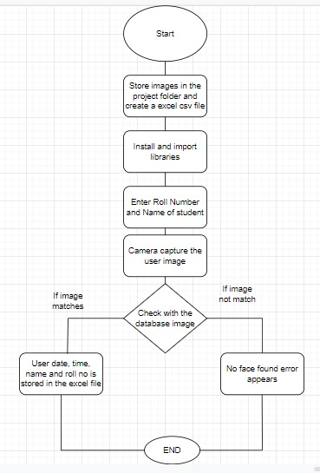
DRY RUN

Slide 7
TOOLS & TECHNOLOGIES
SOFTWARES/TOOLS:
i. Pycharm
ii. Jupyter Notebook
iii. Open Source Libraries
iv. Webcam
TECHNOLOGIES:
i. Artificial Intelligence and Machine learning
ii. Computer Vision

Slide 8
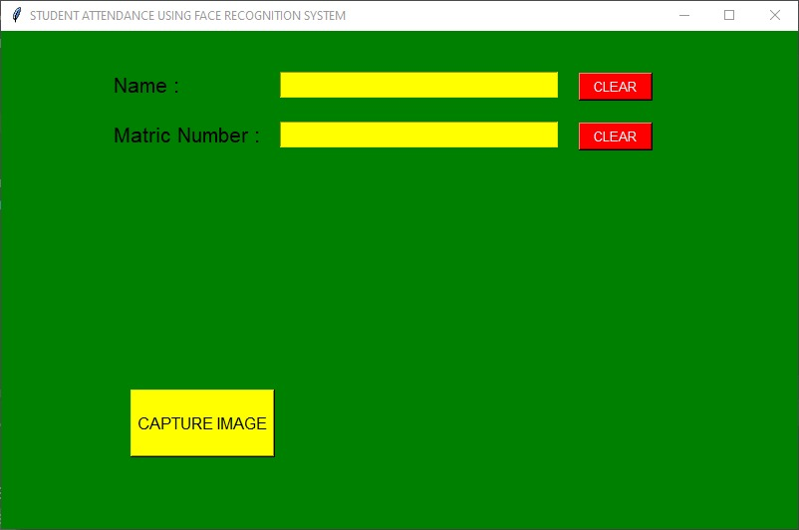
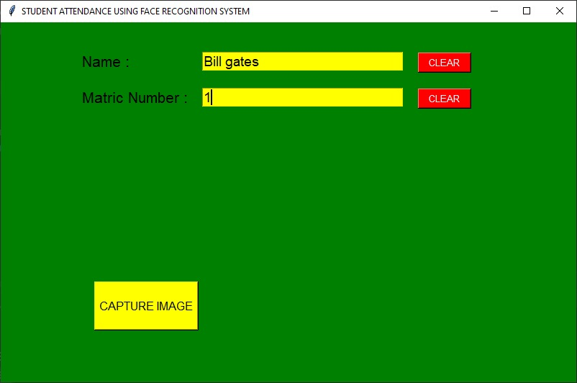
OUTPUT/RESULTS
WEB INTERFERENCE

Slide 9
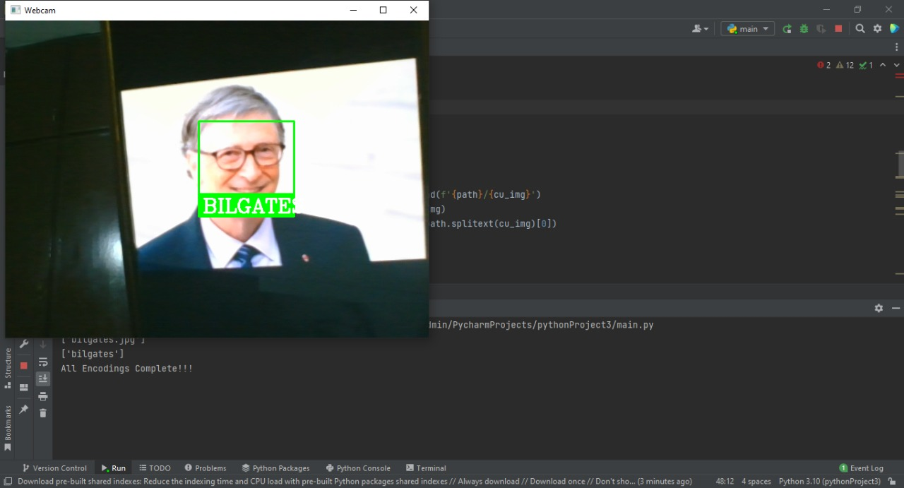
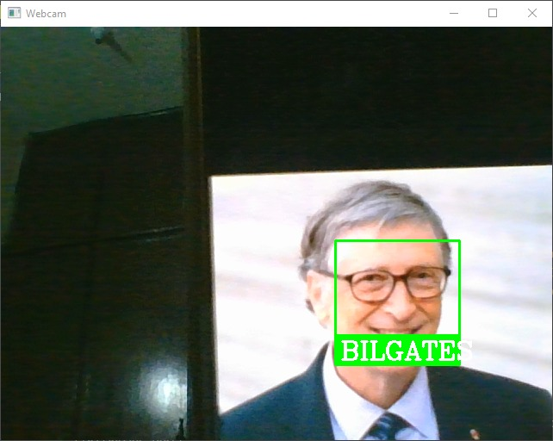
FACE RECOGNITION

Slide 10
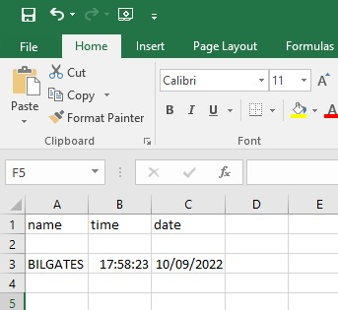
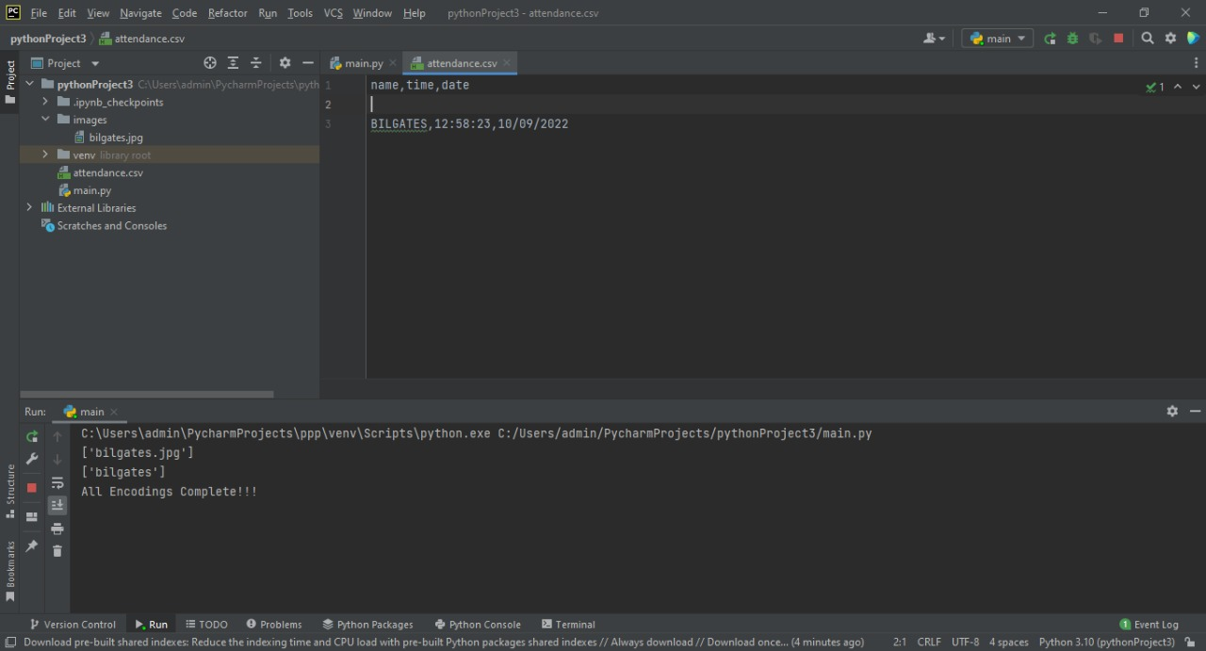
ATTENDANCE MARKED IN CSV FILE (EXCEL)

Slide 11
YOUTUBE VIDEO LINK
https://youtu.be/N0J5O-zQpjI
(Channel Name: smart-attendance)

Slide 12
THANK YOU!

